Slide 1

Welcome
To
Mario jumping game

Slide 2

Now, its time
To start the
Mario jumping Game

Slide 3
Step first:
start the game.

Slide 4
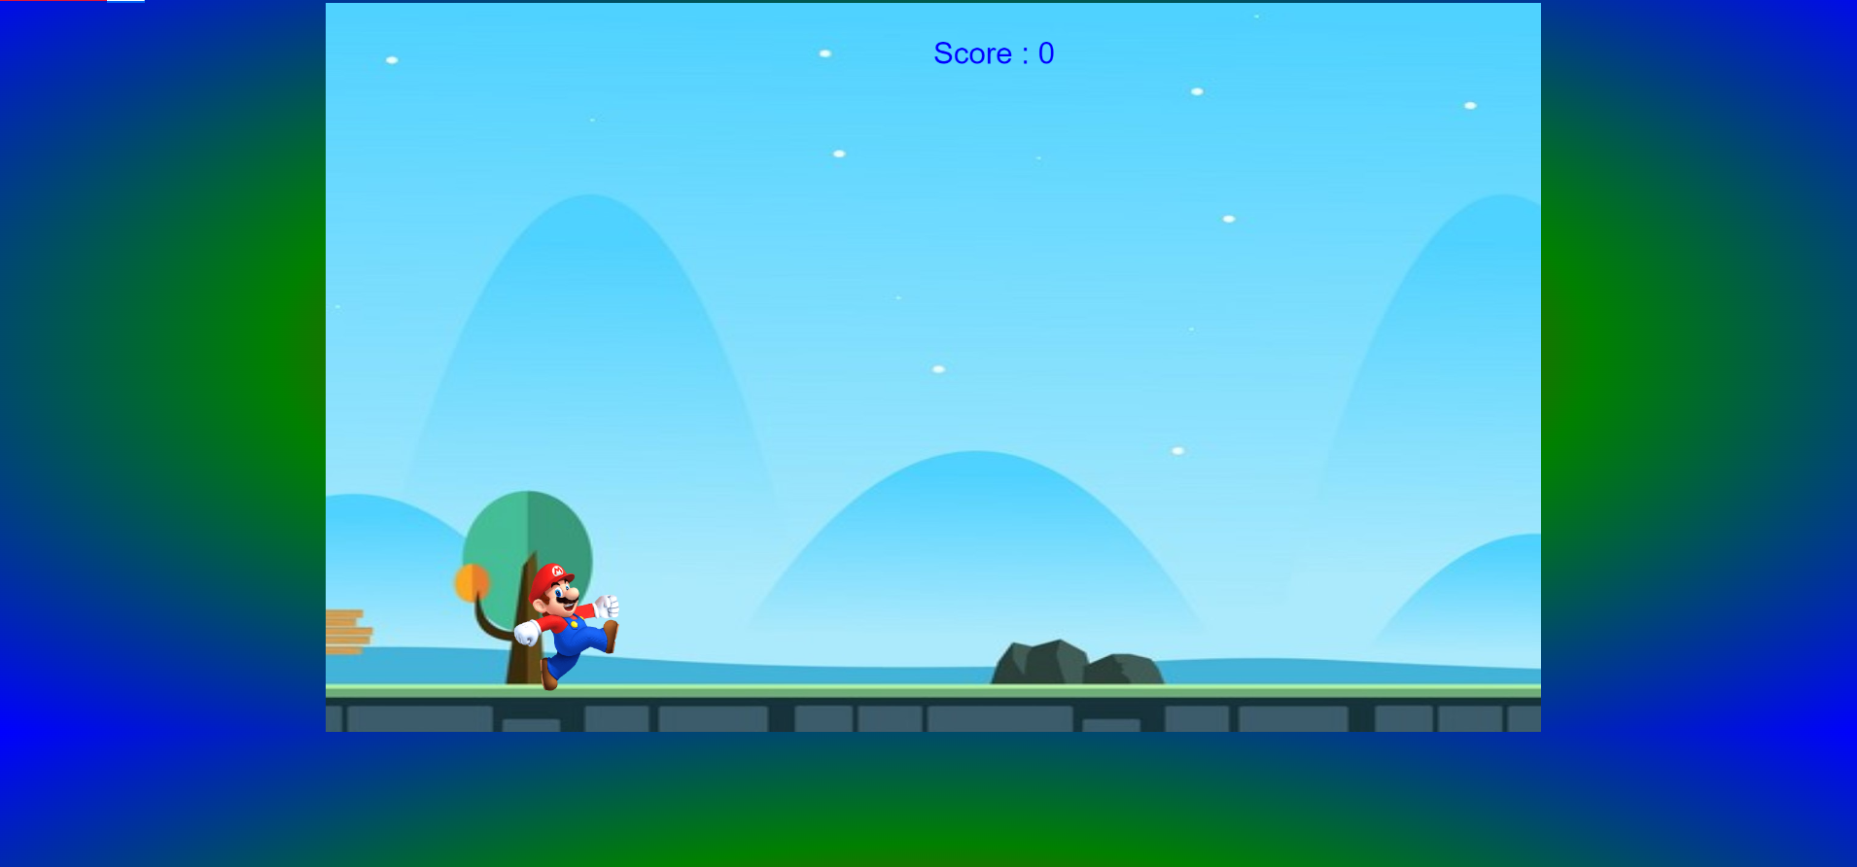
The game is now started.

Slide 5
Step second :
collect the coins.

Slide 6
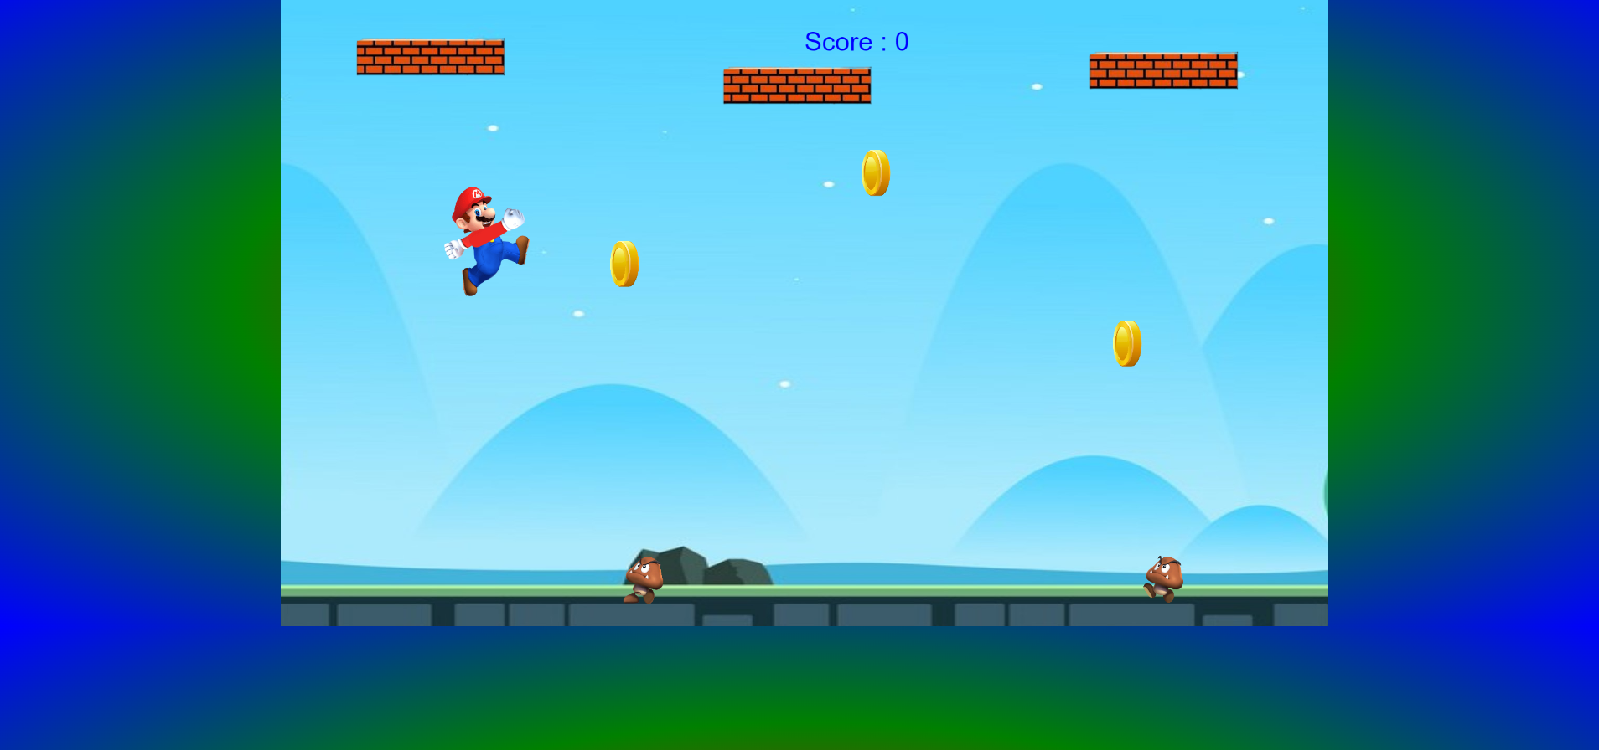
Mario takes the coins through jump.

Slide 7
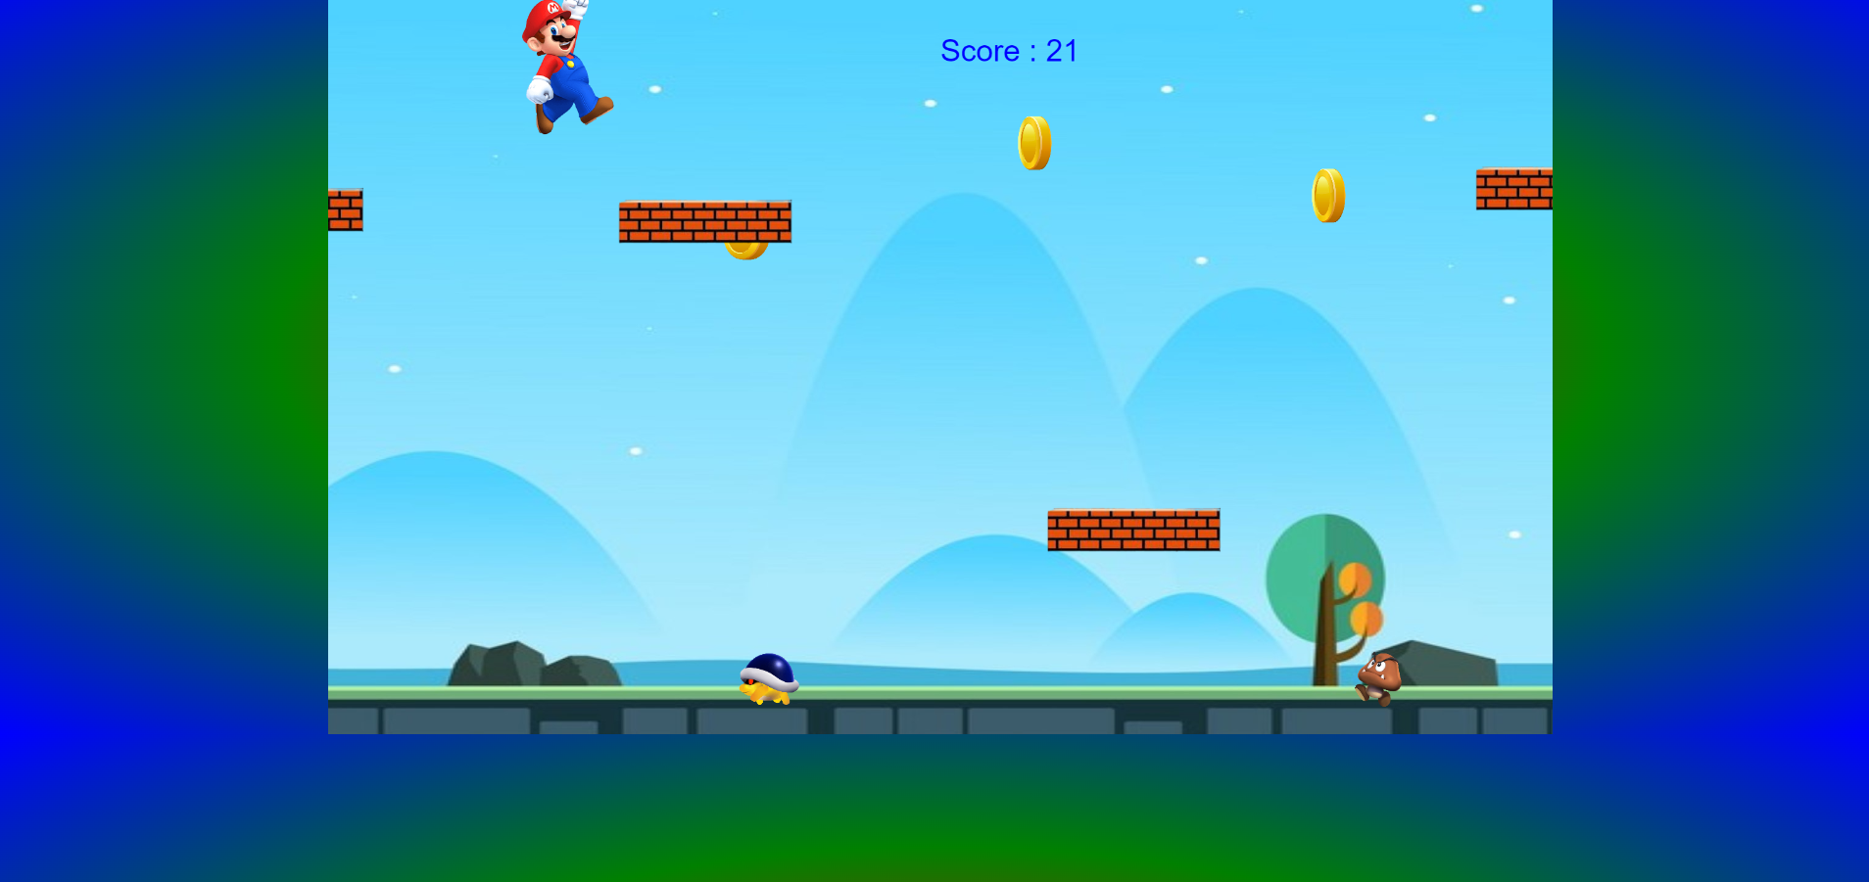
Then the score increases.

Slide 8
Step Third :
when you get out.

Slide 9
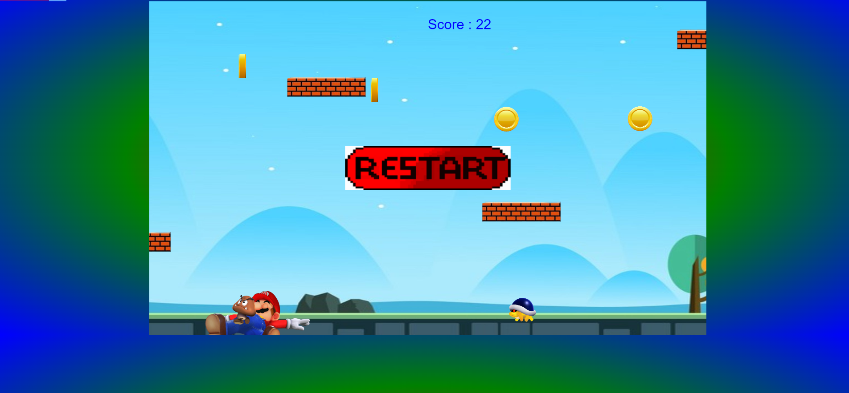
When the Mario touches or jump onto a turtle or a mush then, it gets out the game and the restart button shows on the screen.

Slide 10
Step Fourth:
Then you can click the restart button.
And, then the game restart begin.

Slide 11


Slide 12
Thank
you
sir

